Slide 1
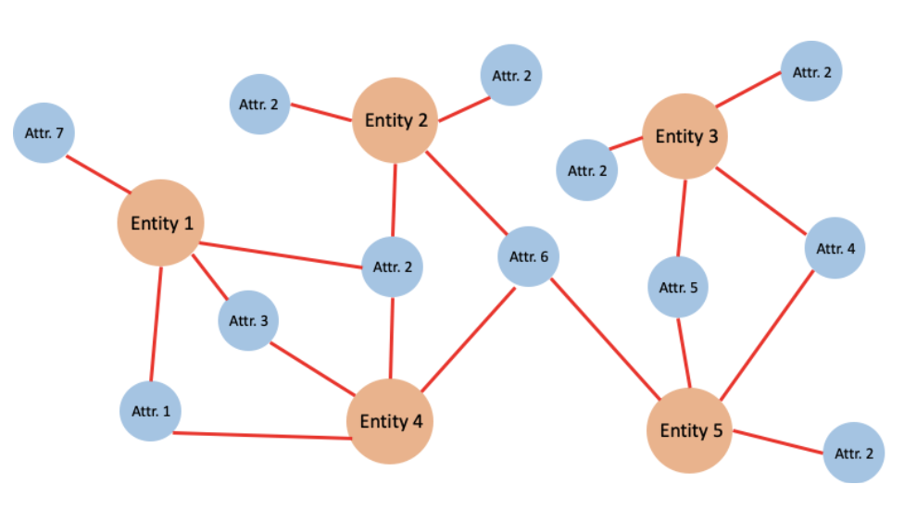
Entity Resolution and Record Anonymization
Anthony J. Fontana

Slide 2
Outline
Definitions
Problem Description and Example
Problem Decomposition
Tentative Solutions
Algorithmic Complexity
Summary
Future Pathways
Impact on Record Anonymization

Slide 3
Definitions
Entity: Using Master data management Jargon, A single unique object in the real world that is being mastered, having certain properties and attributes. Examples of an entity are a single person, single product, or single organization.
Universally Unique Identifier: A global one-to-one mapping between an entity and arbitrary sequence of bits theoretically guaranteed to minimize collision between other UUID’s generated by the cryptographic hash function.
Entity Resolution: A family of techniques designed to link multiple instantiations of an entity, typically realized within datasets from disparate source systems or generating processes, based on observable attributes.
Not to be confused with Named Entity Recognition (NER)
Sometimes referred to as “Record Linkage” or “Deduplication”

Slide 4
Problem Description
Modern Enterprise Software Architecture is typically distributed in order to serve the technical needs of various business segments.
Different groups within the enterprise hosting consumer facing interfaces will have varying standards for data capture, processing, and storage.
Due to this segmentation and lack of standardization, it can become difficult to answer simple questions about customer interaction with an enterprise.
This problem becomes more complex if an enterprise uses multiple Customer Relationship Management (CRM) Systems, acquires a subsidiary (data migrations) or deals with intermediaries between data producer and the data consumer.
Key Question: If a customer's profile is not standardized, how can we guarantee we are referring to the same customer when we aggregate the data across the various systems? (Inference and basic summary statistics will likely be inaccurate)

Slide 5
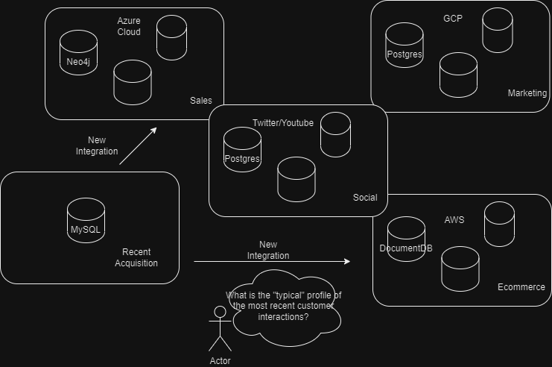
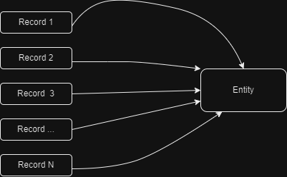
Problem Description
We need to integrate all the potential interactions of an entity from different source systems into a unified location, connect records from each system into a unified entity, assign an identifier, and distribute the identifier back to the originating systems. As we will see in a moment, we need the entire digital footprint in order to properly infer which records associate with which entities.

Slide 6
Problem in Depth
1
2
Suppose we only have 2 records, we can reasonably classify them as one Entity based on the given evidence
AJ Fontana
555 Cherry Lane
209-555-2020
AJ Font.
555 Cherry Lane
Fax# 111111

Slide 7
Problem in Depth
1
2
Now add a third record without an address or phone number, is there sufficient evidence to warrant grouping this record with the other two despite limited similarities?
AJ Fontana
555 Cherry Lane
209-555-2020
AJ Font.
555 Cherry Lane
Fax# 111111
3
Fontana
209-202-2020

Slide 8
Problem in Depth
Now add a fourth record. It has the same address as the other three, but no first name and a different number, how do we handle this? 3 and 4 have similar information, lets group them into a new entity.
1
2
AJ Fontana
555 Cherry Lane
209-555-2020
AJ Font.
555 Cherry Lane CA
Fax# 111111
Fontana
209-202-2020
4
Fontana
555 Cherry Lane NYC
209-202-2020
3

Slide 9
Problem in Depth
So far there are 2 entities and 4 contacts. Let's add a 5th. How do we group this? It looks very similar to 1 and 3. Maybe this is enough evidence to suppose that 1 and 2 should no longer be grouped, and instead 1,3, and 5.
1
2
AJ Fontana
555 Cherry Lane
209-555-2020
AJ Font.
555 Cherry Lane CA
Fax# 111111
1 needs a UUID reassigned, and 5 needs to be assigned with 3 (hypothetically)
Fontana
209-202-2020
4
Fontana
555 Cherry Lane NYC
209-202-2020
3
5
Fontana
Cherry Lane
209-555-2020

Slide 10
Problem in Depth
Now it looks like there are still 2 entities, but they are associated with different contacts now! And now 2 is free floating! lets also suppose 4 updated their information!
1
2
AJ Fontana
555 Cherry Lane
209-555-2020
AJ Font.
555 Cherry Lane CA
Fax# 111111
Now 2 and 4 have the same address! And almost the same name! is this enough to group them? Let's try. This breaks the 3 to 4 connection.
Fontana
209-202-2020
4
AJ Font
555 Cherry Lane CA
209-202-2020
3
5
Fontana
Cherry Lane
209-555-2020

Slide 11
Problem in Depth
Let’s finalize with one last entity. Number 6 sure looks like number 1. Let's connect the two. But it also looks like number 2! Let's connect it.
6
AJ Font
555 Cherry Lane CA
209-555-2020
1
2
It looks like the 6 contacts collapse into one entity! But we now must reassign number 2 a new ID.
AJ Fontana
555 Cherry Lane
209-555-2020
AJ Font.
555 Cherry Lane CA
Fax# 111111
Fontana
209-202-2020
4
AJ Font
555 Cherry Lane CA
209-202-2020
3
5
Fontana
Cherry Lane
209-555-2020

Slide 12
Discussion
A prerequisite for entity resolution is to pipe the relevant data into a centralized location
A canonical data model can serve as a reference for all source systems. Each data source will map source system attributes to the canonical attributes in a data warehouse.
Entities can be regrouped when new information comes into source systems.
Entities can be regrouped if someone updates their contact information.
This has downstream implications if global identifiers are changing.
Why not enforce and join on primary keys, resulting in a rough approximation?

Slide 13
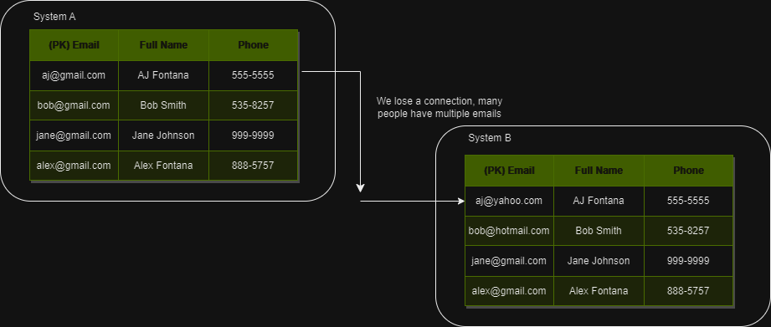
Approach 1: Utilize Primary Key
If you enforce an enterprise-wide PK, there is no reason to assume your customers will use the same input
In general, rule-based matching heuristics will not scale well.

Slide 14
Possible Improvements?
When we ingest data, we should standardize the records using regular expressions and text preprocessing.
Can we use a more sophisticated matching algorithm to do “smarter” matching?
How about brute force comparison using some distance measure after standardization?
How about a clustering algorithm?

Slide 15
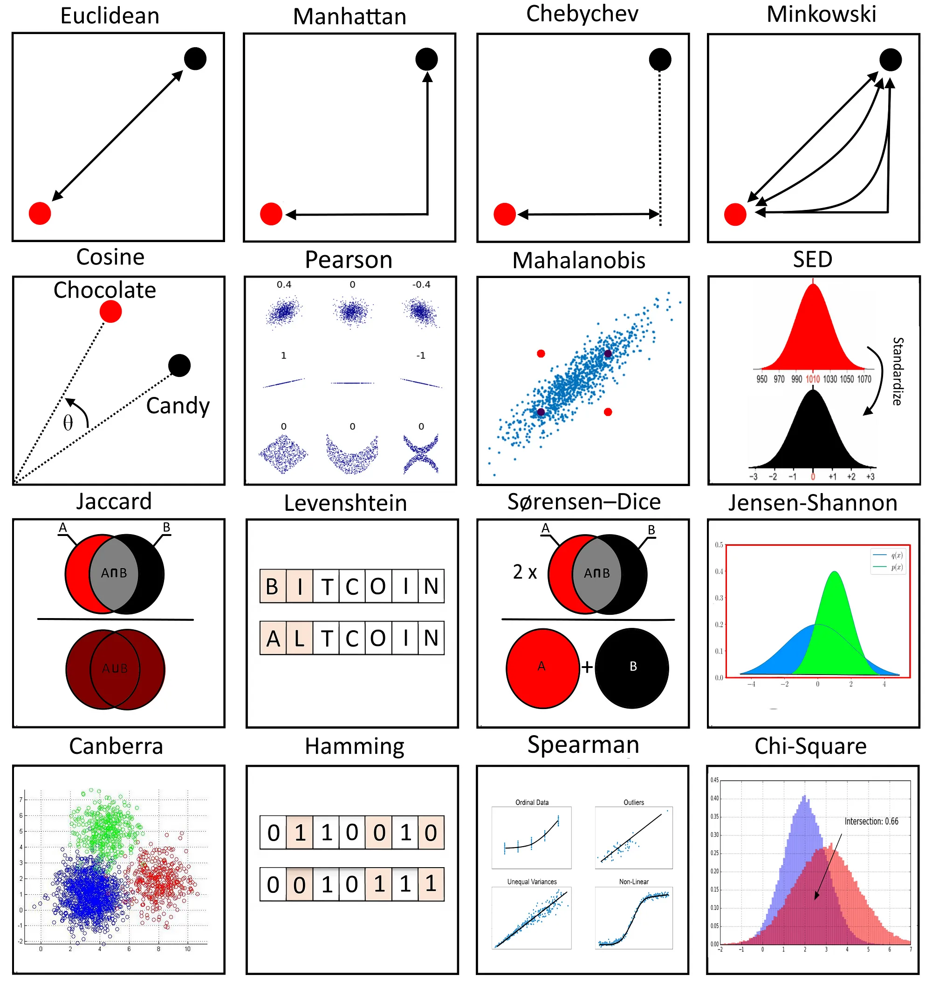
Distance Based Similarity Score
n-grams and k-shingling: after standardizing a document (removing stop words, punctuation, white spaces, converting to lower case, lemmatization) create a set of contiguous sequences of N tokens derived from the document. The optimal choice is context dependent; size of the document. In general, all NLP algorithms (and entity resolution more broadly) will depend on this step. Both steps involve representing the set of n-grams or k-shingles as a binary vector.
There are many similarity metrics to choose from, but the ones listed below seem to be most common in NLP applications:
Cosine Similarity
Manhattan Distance
Euclidean Distance
Minkowski Distance
Jaccard Similarity (intersection over union)

Slide 16
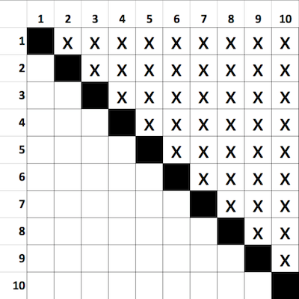
Problems with Naïve Solutions
Consider the brute force method. There are two problems: Arbitrariness of threshold and time complexity.
1 million records leads to 499,999,500,000 comparisons
Unsustainable growth rate
If new data is frequent, this will not scale.
(N-1)*N/2; O(n^2).

Slide 17
Clustering Methods
K-NN O(N*d)
For each point in your dataset compute a distance function with (d) as the number of columns
Seems arbitrary selecting the correct K
K-means clustering O(n^2)
The drawback seems to be arbitrariness of selecting number of clusters a-priori
DBSCAN: Best Case O(n*log n), Worst Case O(N^2)
Visits each point in a dataset only once and determines if it is in a high-density neighborhood (based on ε-neighborhood and min_points params)
Beneficial that number of clusters does not need to be pre-specified
Sensitive to parameter specifications
Hierarchical Clustering O(N^3)
Using the divisive hierarchical all observations start in one cluster, and splits are performed recursively as one moves down the hierarchy.
We need to compute similarities between the clusters to decide when to merge or divide as we recurse, storing them in a similarity matrix.
We need to perform n iterations, and, in each iteration, we need to update the similarity matrix and restore the matrix. Time complexity will be very high.

Slide 18
Clustering Methods Discussion
Each method seems to have high time complexity
Each method seems sensitive to parameter selection
The results are not necessarily interpretable
Training data seems hard to come by since most of it will contain personally identifiable information. Synthetic datasets could be of use to train the models.
We need to have a general solution that preserves accuracy while radically reducing the search space.

Slide 19
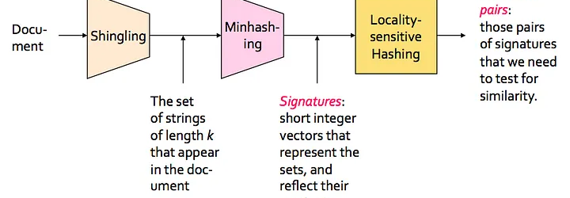
Locality Sensitive Hashing
Mining Massive Datasets provides a chapter explaining a family of techniques known as Locality Sensitive Hashing. This is used to reduce the dimensionality of the data. It has many applications, including identifying near identical documents.
A concatenation of attributes can be conceptualized as a document, and hence we can use this technique.
Given a list of N documents, each represented by a D-dimensional binary vector (as a product of shingling), find all pairs of documents with Jaccard similarity above some threshold. The shingle matrix has documents as columns, all possible shingles as rows, and a binary value (0,1) represented if the shingle is present in the document.
Minhashing allows us to avoid comparing all vectors.

Slide 20
Locality Sensitive Hashing
LSH Reduces to complexity to O(n)
Locality-sensitive hash functions are designed such that hash value collisions are more likely for two input values that are close together than for inputs that are far apart.
LSH essentially clusters similar documents together before doing any comparisons by means of maximizing probability of collision.
Different LSH functions pair with different distance metrics.
Given documents D1 and D2
If we can find a hash function h such that:
if sim(D1,D2) is high, then with high probability h(D1) = h(D2)
if sim(D1,D2) is low, then with high probability h(D1) ≠ h(D2)
Then we could hash documents into buckets and expect that “most” pairs of near duplicate documents would hash into the same bucket and then we have set of candidate pairs of docs in each bucket to see if they are indeed similar.

Slide 21
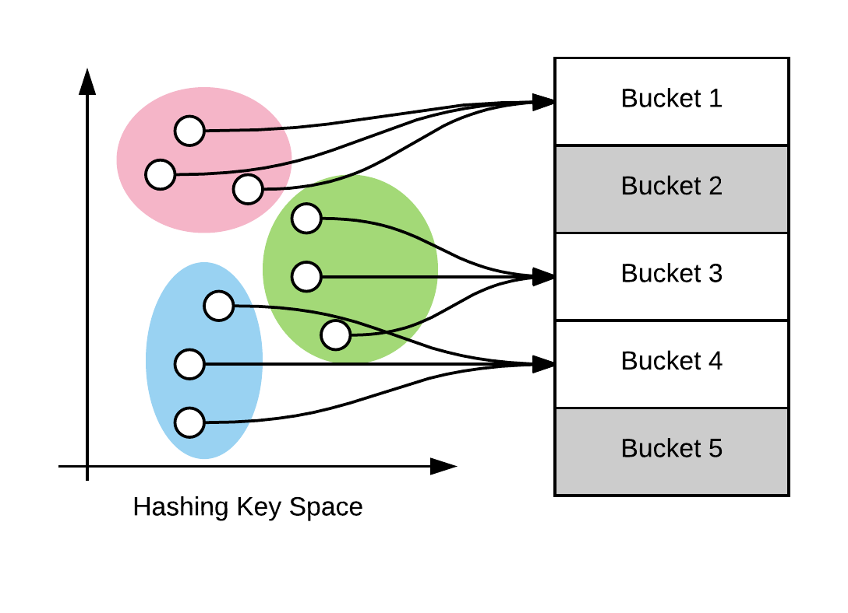
Locality Sensitive Hashing Intuition
The clustering in the data is more likely to be preserved. Data in the pink cluster does not need to be compared to data in the green cluster.
LSH preserves the local relations of the data.

Slide 22
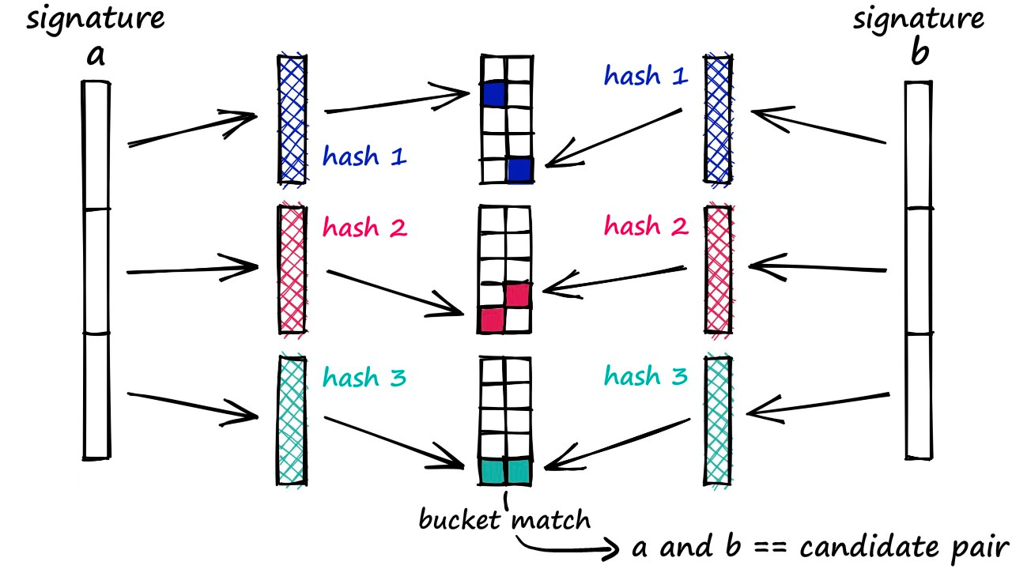
Pseudocode
Define a function that generates Shingles (n-grams); contiguous subsequences of tokens in a document. Create a sparse vector.
Define a Jaccard similarity function; ratio of intersection over union of two sets of shingles.
Define Minhash function (H) that converts the sparse vector (from step 1) into a Signature (dense vector): short integer vectors that represent the set and reflect their similarity. If two vectors are similar, they will likely have an identical signature. At this step, we create a Signature Matrix. Different vectors could have the same hash value, but there are proofs that show this is unlikely.
Define a LSH function. Only compare the elements in each bucket now with the Jaccard function. Remember that we are taking similarity of signatures from step three as a proxy for Jaccard similarity between the original documents. We want to identify documents with Jaccard similarity of at some threshold. The LSH function splits the signature into sub-vectors, applies another hash function to the sub-vector, bucketing the value into a bin. The point is to maximize hash collisions! Similar documents, similar hash codes, same bins.
Expected Similarity of two signatures is equal to the Jaccard similarity, so we bucket the documents according to this rule and then do the final Jaccard comparison with some threshold!
Shingle - > One-Hot encode (sparse vector) -> Apply MinHash - > Signature -> LSH

Slide 23
Locality Sensitive Hashing Use Cases
Uber: To detect fraudulent drivers, similar trips are detected based on their spatial properties. Switching from O(N^2) method to the LSH, the computation time decreased from 55 hours to just 4 hours.
Google: VisualRank - Google's image search technology uses LSH to find similar images at scale.
Genome-wide association study: LSH is used for finding similar gene expressions in genome databases.

Slide 24
Locality Sensitive Hashing Drawbacks
You still need to define a threshold when comparing similar sets within bins.
You need to identify the optimal sub-vector split.
Probabilistically, the clusters are preserved from the original data. It is not impossible for matches to be hashed to the wrong bins.
Selecting the correct distance function and corresponding LSH function is cumbersome and not always clear. For example, cosine distance requires an entirely different LSH function “Signed Random Projections”.
Difficult to explain to stakeholders

Slide 25
Other Approaches in Industry
Represent Entities in a Graph data structure. We alluded to this in the earlier example. Define a graph schema and feed your data into the database. Graph structures allow you to identify local neighborhoods.
Latent Dirichlet Allocation and other Bayesian approaches. LDA introduces a hidden ‘group’ hidden variable to capture collections of entities which are commonly observed together. These methods have the benefit of being unsupervised.
Commercial solutions that leverage machine learning methods.

Slide 26
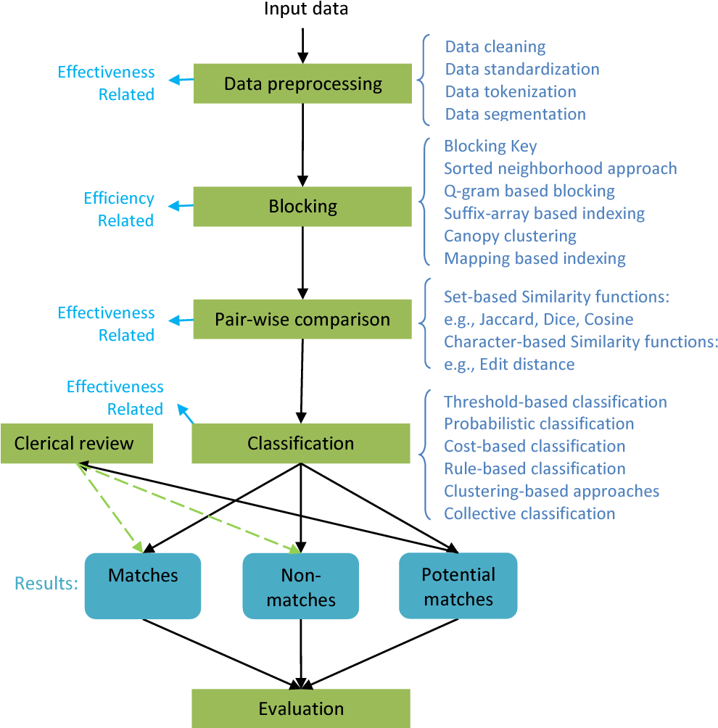
Very General Procedure for all ER Strategies
Every procedure will attempt to find a reasonable way of reducing the search space

Slide 27
Connection to Record Anonymization
The ER pipeline enables you the ability to assign a Global Unique Identifier to every instantiation of an entity. With this, you can mask PII information while retaining a connection to every record across the enterprise.
If you do not have a proper Entity Resolution (ER) pipeline, this can have downstream impacts.
When you lack a global view of a customer across disparate enterprise systems, you can potentially be at risk for non-compliance with CCPA or GDPR .
Enterprise data management needs to be able to identify all instantiations of an entity across the organization at low cost (measured by FTE hours) and minimal effort.
Furthermore, if you are unable to identify every instance of a record containing PII, you will be at risk and liable in the event of a data breach.

Slide 28
Record Anonymization
Without a global identifier, anonymizing records will render them useless because there will be no way to connect back to that record.
Even if you mask PII data, the enterprise can still be at risk if enough non-identifying attributes are available across your systems to enable a probabilistic inference about the anonymized entity.
One approach to mitigate this problem is k-anonymity. A record is said to be anonymized provided there are scientific guarantees that the individual subjects cannot be reidentified, conditional on the dataset retaining use.
L-Diversity is an extension, it seeks to reduce the granularity of the data representation, such that individuals who are masked cannot be statistically inferred to a level degree of accuracy.

Slide 29
Summary
Entity resolution is not a solved problem.
To have an effective ER strategy, coordinating across all business units involved is the first step for improving the performance of any algorithm you adopt. Data Governance should be involved.
Adopting an ER strategy will help you solve compliance requests related to CCPA and GDPR.
You achieve dual objectives: the enterprise achieves record anonymity while retaining maximal value from the data.

